Slide 1
Multi-Task Learning for Dense Prediction Tasks
By
Vijaylaxmi Nagurkar

Slide 2
INTRODUCTION
What is meant by dense prediction tasks?
In computer vision, pixel wise dense prediction is the task of predicting a label for each pixel in the image. Because we’re predicting for every pixel in the image, this task is commonly referred to as dense prediction.
Recent advancements in deep learning have further more enhanced dense prediction tasks. These tasks are learned separately, but with advent of multi-task learning, when these tasks use a shared representation, there is a significant improvement in performance.
The paper presents multi task learning first from a network architecture point-of-view,
It examines various optimization methods, exploring the similarities, differences, pros and cons of both the strategies.

Slide 3
Why do we need multi task learning
Tasks such as semantic segmentation are are handled in isolation.
In real-world problems, which are multi-modal, isolating the task would not work. For example, in case of autonomous car driving, the car system should be able to identify or segment lanes, detect for objects in distance and many more.
Biological data processing is one more example.
There was a dire need to develop such models can project all desired outputs with a given input.
Multi task learning leverages domain-specific information contained in the training signals of related tasks.
The advantages of multi task networks is the reduction in memory footprint due to sharing of layers.
There is an increase in inference speed as the features have to be calculated only once.

Slide 4
Deep multi-task architectures
Non deep-learning methods: Assumptions such as closeness of task parameters, parameters should lie in low-dimensional subspace. These assumptions didn’t work well for unrelated tasks.
Soft and Hard Parameter Sharing in Deep Learning: In hard parameter sharing which uses encoders branching out into task-specific heads, parameter set is divided into shared and task-specific parameter. In soft parameter sharing, each task has its own parameters, and there is coordination between tasks using a feature sharing mechanism.
Distilling Task Predictions in Deep Learning:This follows a recursive approach to make predictions. An initial task prediction is made, which is further used to improve future predictions.
A New Taxonomy of MTL Approaches: This approach takes into account locations where the information exchange happened between tasks, which further branches to encoder-focused and decoder-focused architectures.

Slide 5
Encoder focussed architectures
Task features are shared in encoding stage.Model is completely dependent on encoder to learn the generic representation.
Cross-Stitch Networks: Pre -trained single-task networks, shared activations. Linear increase in network size with number of tasks.
Neural Discriminative Dimensionality Reduction: Similar architecture as Cross-Stitch, with the exception that dimensionality reduction is used.
Above two have scalability issues and design overheads.
Multi-Task Attention Network: Shared backbone network.Feature selection from general pool using soft attention mask, using sigmoid and convolutional layers.
Branched Multi-Task Learning Networks:Hard parameter sharing . Initial layers are more inclined towards more general low-level image features, while the deeper layers is more into task-specific information.

Slide 6
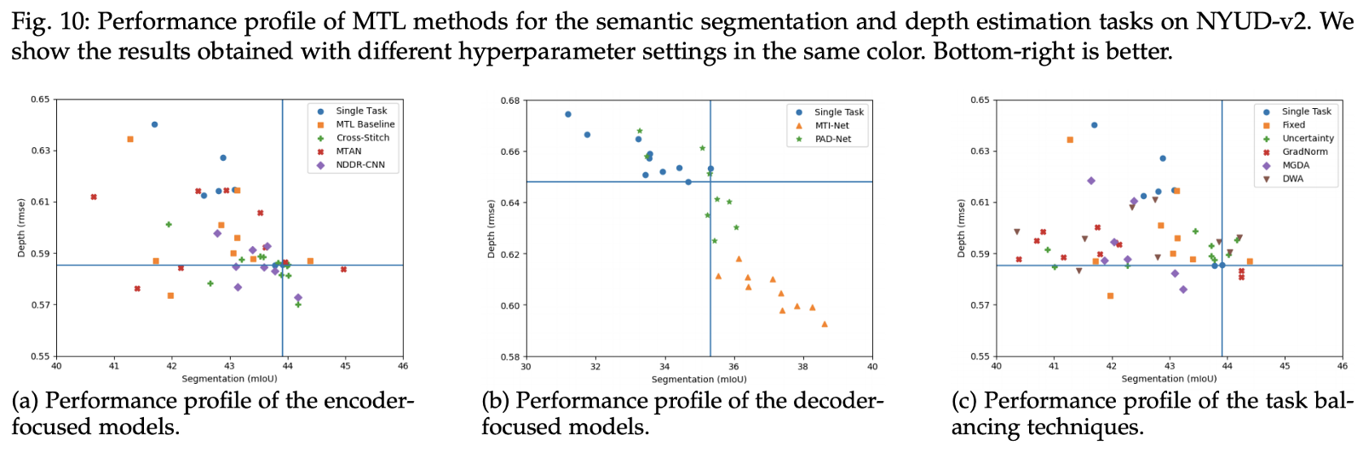
Encoder and Decoder architectures

Slide 7
Decoder focussed architectures
Overcome the failures of encoder-focussed architectures
Multi task network predicts the initial task predictions and then recursively leverage features to further improve.
PAD-Net: Input image is first processed by an off-the-shelf backbone network. The backbone features are further processed by a set of task-specific heads that produce an initial prediction for every task.
Pattern-Affinitive Propagation Network:((PAP-Net): similar to PAD-Net ,but the multi-modal distillation in this work is performed in a different manner. Joint Task-Recursive Learning: Two tasks are predicted recursively to gradually improve results
Multi-Scale Task Interaction Networks: Task interactions is performed in multiple scales.The distilled multi-scale features are upsampled to the highest scale and concatenated, resulting in a final feature representation for every task.

Slide 8
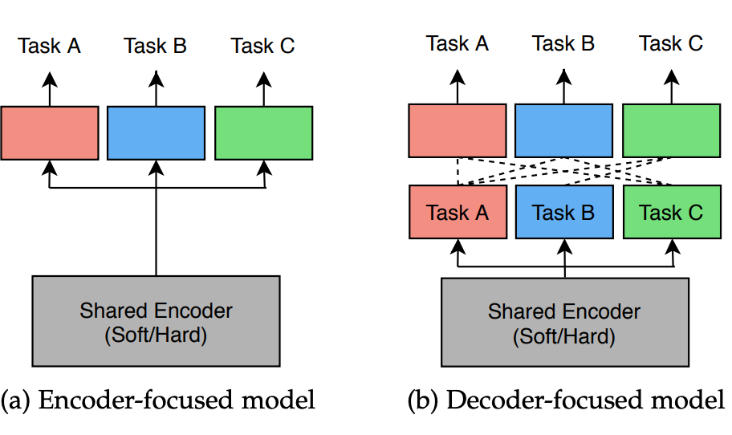
Other approaches
Multilinear relationship networks: Used tensor normal priors to the parameter set of the task-specific heads
Attentive Single-Tasking of Multiple Tasks :Separate forward passes are performed within a multi-tasking framework.

Slide 9
Optimization
As the tasks learn shared representations, we need to carefully balance this learning to avoid the prevalence of any one task in network weights.
Uncertainty weighting:The task-dependent uncertainty is not an output of the model, but a quantity that remains constant for different input examples of the same task.
Gradient Normalization: Task-specific gradients equal in magnitude.
Dynamic Weight Averaging: To balance the pace of task learning.
Dynamic Task Prioritization:Learning of difficult tasks are prioritized by assigning them a high task-specific weight, so that the network spends more time to learn difficult tasks.
MTL as Multi-Objective Optimization: Based on the concept that the loss for any task can be decreased without increasing the loss on any of the other tasks.

Slide 10
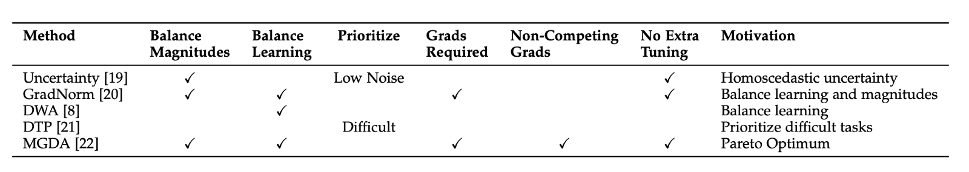
Experiments
The paper also talks about the various experiments conducted. These were particularly conducted on NYUD-v2 [72] and PASCAL [73].For performance evaluation of multi-task models, a single-number performance metric was used.
For training, experiments are performed using pre-trained ImageNet weights. Loss function and augmentation strategy was reused. Grid search procedure is used to optimize learning rate, batch size and optimizer.

Slide 11
Experiments continued...
Single-Task vs Multi-Task: Multi task learning has many advantages over single-task. For example, smaller memory footprint, reduced number of calculations, and improved performance.
Influence of Task Dictionary: Tasks of semantic segmentation and depth estimation are considered.They pose similar observations for layout and boundaries.
Architecture vs Optimization: Used to improve performance.
Encoder- vs Decoder-Focused Models: The observation shows that decoder-faced models have an edge over encoder-focused.But each of these models have their own utility.Encoder focused learn during the encoding process, while decoding focused follow a recursive approach and improve iteratively

Slide 12
Architectures
Encoder-Focused Architectures
Sharing a ResNet backbone in combination with strong task-specific head units proves a strong baseline for solving a pair of well correlated dense prediction tasks, like semantic segmentation and depth estimation.
Encoder-Focused Architectures
They report significant gains over single-task.h PAP-Net and JTRL incur a large increase in the number of FLOPS. MTINet and PAD-Net provide more viable alternatives.PAD-Net can not handle the larger task dictionary. The low performance on the semantic edge prediction task can be attributed to not using skip connections in the implemented model.

Slide 13
Related domains
Multi-Domain Learning:The methods were applied on same visual domain.Going forward, there is growing interest for multi-domain representations using domain specific scaling parameters.
Transfer Learning: It uses knowledge from one task to tackle another and unlike multi-task learning, does not solve all tasks concurrently.The question which arises is whether visual tasks are correlated. Multi-gate Mixture-of-Experts(MOME) are used to model the task relationships.
Neural Architecture Search:For multi task learning to succeed, proper network architecture should be selected. The paper proposes the automation of network architecture over manual architecture , which can have size complexities.
Other: Multi task learning has also been applied to various domains like audio, video, language, robotics with different learning paradigms like reinforcement learning , self-supervised learning, semi-supervised learning and active learning.

Slide 14
Conclusion
The paper reviewed recent methods for multi task learning within deep neural networks.Architecture and optimization strategies were studied and extensive experiments were conducted to obtain several valuable findings.Findings included importance of task dictionary, advantages of decoder focused architectures, and analysis of multiple task balancing strategies. There is an ongoing research in this area.

Slide 15
References
https://arxiv.org/pdf/2004.13379.pdf

Slide 16
Thank You

